Slide 1
Determinants of Equilibrium output and IS_LM Model

Slide 2
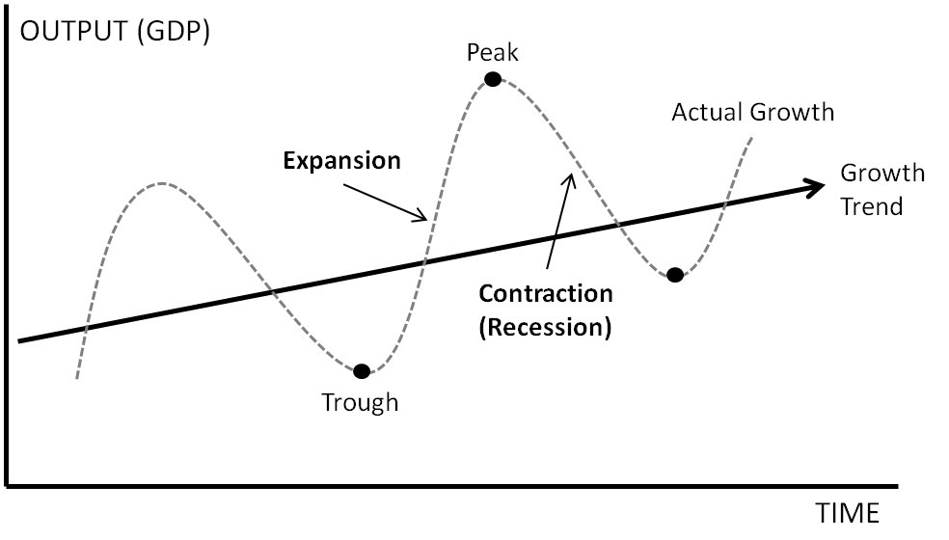

Slide 3
Goods market , Money market an their interdependence
Goods market ( I=S)
Money Market (L=M)

Slide 4
Concepts
Aggregate supply:
The total quantity of output firms will produce and sell—in other words, the real GDP.
Slopes upward, shows the positive relationship between price level and real GDP in the short run
Slopes up because when the price level for outputs increases, while the price level of inputs remains fixed, the opportunity for additional profits encourages more production.

Slide 5
Full-employment GDP:
The maximum quantity that an economy can produce given full employment of its existing levels of labor, physical capital, technology, and institutions.
Aggregate demand:
The amount of total spending on domestic goods and services in an economy.
downward-sloping, shows the relationship between the price level for outputs and the quantity of total spending in the economy.

Slide 6
Introduction to the Keynesian system
The Keynesian system is based on the principle of aggregate demand
In the short period (that is, the time period in which productive capacity is fixed within narrow limits), real output and employment are determined by aggregate demand.
Aggregate demand (AD) is defined as total or aggregate spending for newly produced goods and services.

Slide 7
Components of Aggregate Demand (AD)
For an open economy with government
AD = C + I + G + NX
C, I, and G mean the same thing as always; NX is net exports

Slide 8
Generally AD depends on level of income.
We shall assume amount of goods demanded is constant.
If goods demanded is constant, what determines the actual level of income?
For that we need equilibrium level of output

Slide 9
Equilibrium with constant AD
AD = Y
IU is unplanned inventory investment
Aggregate demand
IU > 0
E
6
AD
IU < 0
45⁰
0
6
8
Output

Slide 10
Properties of Equilibrium
At equilibrium AD = output
AD= C+I+G+NX = Y
Planned spending is equal to real output, meaning the plans of spending and producing units match up.
Unplanned inventory investment is equal to zero.
Firms on average have no reason to expand or contract the scale of production. Nor they have a reason to offer more or less employment.

Slide 11
$8 trillion is a disequilibrium value of real output
AD = Y
IU = Y - AD
Aggregate demand
E
IU = $2 trillion
6
AD
IU < 0
45⁰
0
6
8
Output (trillions)

Slide 12
AD: Its determinants
for equilibrium: AD = Y [1]
AD= C+I+G+NX
In a closed economy with no public sector:
AD = C + I [2]
⇒ Thus, developing a theory of aggregate demand logically begins with a theory of consumption and a theory of investment.

Slide 13
The consumption function
The consumption function is given by:
C
>
0
0 < c < 1
I is the intercept of the consumption function, or the component of planned household spending determined independent of income.
‘c’ is the marginal propensity to consume-the change in consumption resulting from a one unit change in disposable income.
C

Slide 14
The consumption function
AD = Y
Aggregate demand
.
45⁰
0
Y₀
Income, Output

Slide 15
The saving function
The slope of the saving function is given by MPS
S
S = -30 + .3Y
30
0
100
200
Y
-30
S
=
Y
−
C
◊
Y
−
+
(
C
cY
)

Slide 16
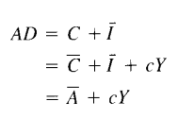
The investment function

Slide 17
The consumption & investment function and AD
AD = Y
=
+
E
AD
A
cY
AD₀
Aggregate demand
Eo
45⁰
0
Y’
Y₀
Income, Output

Slide 18
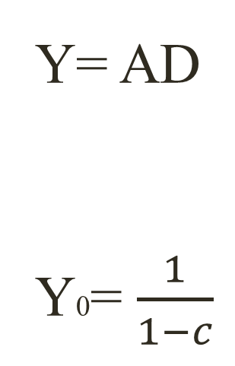
Alternative way to find equilibrium
Y= AD
Y0= $\frac{1}{1−c}$
Y =
A
+
cY
A

Slide 19
The Saving & Investment identity
AD = Y
E
AD₀
Aggregate demand
S
M
Eo
45⁰
0
Y
Y₀
Income, Output

Slide 20
Saving investment identity
1. The vertical difference between AD and Consumption schedule = [AD – C = I]
2. The vertical difference between Consumption schedule and the reference line = [ Y - C = S]
So at the equilibrium I = S

Slide 21


The multiplier effect
By how much does a 1 rupee increase in autonomous spending raise the equilibrium level of income?
Additional spending cause an increase in income by ‘c’ times

Slide 22
Round | Initial Injection | Production Changes | Consumption | Saving
1 2 3 4 5 6 -- -- -- | ₹ 1000 | ₹ 1000 750 563 422 316 237 3288 | ₹ 750 563 422 316 237 178 2466 | ₹ 250 187 141 105 79 59 822

Slide 23
The multiplier effect
AD = Y
E
Aggregate demand
AD₀
45⁰
0
Y
ΔY
Y₀
Income, Output

Slide 24
What would be the limit of new employment created if the government undertook to stimulate employment growth by spending for public works projects?
Chain of causation
Expenditure for public works
Increase in employment in construction, trades, and building supplies industries
Increase in income of people employed in these industries
Increase in spending for consumption goods → increase in employment in consumption goods industries.

Slide 25



The Multiplier Effect

Slide 26
The government Sector
AD = C+ I+ G 2.1
Government intervention affects in two ways
Through government purchases
Through taxes and transfers
C= f( Yd) 2.2
Yd = (Y+TR-TA) 2.3
2.4
C
=
C
+
cYd
C
=
C
+
c(Y+TR-TA)

Slide 27
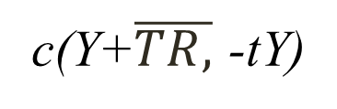

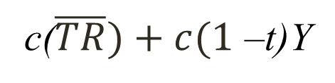
Specification of fiscal policy ( level of G purchases, level of transfers and tax structures)
We assume govt. purchases a constant amount
G= $\overline{G}, TR= \overline{TR,}$ TA= tY
2.5
2.6
C
=
C
+
c(Y+$\overline{TR,}$ -tY)
C
=
C
+
c($\overline{TR})+c(1$ –t)Y

Slide 28

AD= $\overline{C}$+$\overline{I}+\overline{G}+\overline{cTR}+c\left(1−t\right)Y 2.7$
AD= $\overline{A}+c\left(1−t\right)Y$

Slide 29
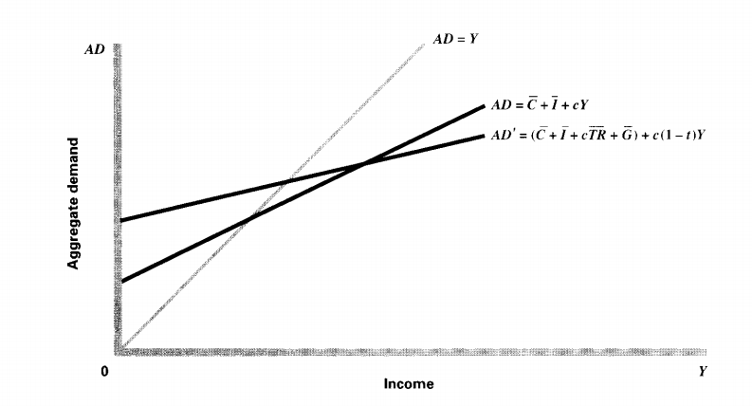

Slide 30
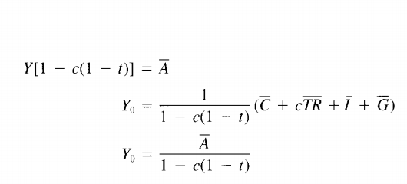
For equilibrium level of income

